Slide 1
Cloud Standards Overview
Cloud-Standards.org

Slide 2
Open Standards
Open Standard: A standard developed with a process open to all interested parties and where implementations are free to use the standard.

Slide 3
Some Possible Standards
Federated security (e.g. identity) across Clouds
Metadata and data exchanges among Clouds
Standards for moving applications between Cloud platforms
Standards for describing resource/performance capabilities and requirements
Standardized outputs for monitoring, auditing, billing, reports and notification for Cloud applications and services
Common representations (abstract, APIs, protocols) for interfacing to Cloud resources
Cloud-independent representation for policies and governance
Portable tools for developing, deploying, and managing Cloud applications and services
Orchestration and middleware tools for creating composite applications across Clouds

Slide 4
Federated Cloud
A federated cloud (also called cloud federation) is the deployment and management of multiple external and internal cloud computing services to match business needs. A federation is the union of several smaller parts that perform a common action. Identity : SSO (Single Sign on)

Slide 5
Standards Groups
In Internet circles, everything eventually gets driven by a working group of one sort or another.
A working group is an assembled, cooperative collaboration of researchers working on new research activities that would be difficult for any one member to develop alone.
exist for anywhere between a few months and many years.
strive to create an informational document a standard, or find some resolution for problems related to a system or network.
attempts to assemble experts on a topic.
Task groups or technical advisory groups.

Slide 6
Standards and Test Bed Groups
Cloud Security Alliance (CSA)
Distributed Management Task Force (DMTF)
Storage Networking Industry Association (SNIA)
Open Grid Forum (OGF)
Open Cloud Consortium (OCC)
Organization for the Advancement of Structured Information Standards (OASIS)
TM Forum
Internet Engineering Task Force (IETF)
International Telecommunications Union (ITU)
European Telecommunications Standards Institute (ETSI)
Object Management Group (OMG)

Slide 7
Cloud Security Alliance (CSA)
The Cloud Security Alliance (CSA) is the world’s leading organization dedicated to defining and raising awareness of best practices to help ensure a secure cloud computing environment.
CSA harnesses the subject matter expertise of industry practitioners, associations, governments, and its corporate and individual members to offer cloud security-specific research, education, certification, events and products.

Slide 8
Cloud Security Alliance (CSA)
CSA operates the most popular cloud security provider certification program, the
CSA Security, Trust & Assurance Registry (STAR), program of self-assessment
More info on
https://cloudsecurityalliance.org

Slide 9
Storage Networking Industry Association (SNIA)
Mission : Lead the storage industry worldwide in developing and promoting vendor-neutral architectures, standards, and educational services that facilitate the efficient management, movement, and security of information

Slide 10
The Open Grid Forum (OGF) is a community of users, developers, and vendors for standardization of grid computing.
Some technologies specified by OGF include:
GridFTP: Extensions to the File Transfer Protocol for high-speed, secure, and reliable data transfer.

Slide 11
OCC mission
Mission Statement
To promote the use of best practices for providing security assurance within Cloud Computing, and provide education on the uses of Cloud Computing to help secure all other forms of computing.

Slide 12
Which Organizations doing What?
 | SaaS | PaaS | IaaS | DaaS
Provisioning |  |  | OGF/DMTF | SNIA
Metering and Billing |  |  |  | SNIA
Security |  |  | OGF/DMTF/CSA | SNIA (IETF)
Privacy
Quality of Service |  |  | DMTF | SNIA
Identity |  | OASIS
Standardization of Cloud Management

Slide 13
Which Organizations doing What?
 | SaaS | PaaS | IaaS | DaaS
Client Application Interface
Development Platform
Virtual Machine Interface |  |  | DMTF
Data Storage Interface |  |  |  | SNIA
Standardization of Functional Interfaces

Slide 14
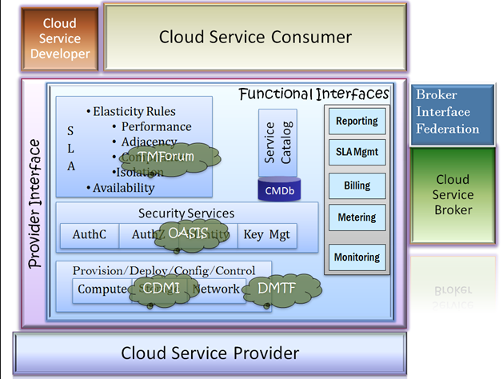

Slide 15
Existing Specifications
SNIA Cloud Data Management Interface (CDMI) http://www.snia.org/cloud
DMTF Open Virtualization Format (OVF) http://www.dmtf.org/standards/published_documents/DSP0243_1.0.0.pdf
OGF Open Cloud Computing Interface (OCCI) http://www.ogf.org/Public_Comment_Docs/Documents/2010-01/occi-core.pdf

Slide 16
Testbeds
Open Cloud Consortium Testbed http://opencloudconsortium.org/testbed/
Open Cirrus Testbed https://opencirrus.org/

Slide 17
Individual Standards Groups

Slide 18
Open Cloud Consortium
The Open Cloud Consortium (OCC) http://www.opencloudconsortium.org/
  Supports the development of standards for cloud computing and frameworks for interoperating between clouds
  supports the development of benchmarks for cloud computing
  Supports reference implementations for cloud computing, preferably open source reference implementations
  it manages testing platform and a test-bed for cloud computing called the Open Cloud Test-bed.
  Sponsors workshops and other events.
  Organized into several different working groups.

Slide 19
Groups
Standards and Interoperability for Clouds - On-Demand Computing Capacity
Hadoop architecture
  storage cloud - a distributed file system
  compute cloud - MapReduce
  data cloud - table services.
  support the concept of on-demand computing capacity.
Group on Wide Area Clouds and the Impact of Network Protocols on Clouds – developing technology for wide area clouds, including creation of methodologies and benchmarks to be used for evaluating wide area clouds.
  it is tasked to study the applicability of variants of TCP and the use of other network protocols for clouds.

Slide 20
Groups
Open Cloud Test-bed uses Cisco C-Wave and the UIC Teraflow Network for its network connections.
C-Wave makes free network resources available to researchers to conduct networking and applications research.
Allows to access 10G Waves (Layer-1 p2p) on a per-project allocation.
It provides links to a 10GE (gigabit Ethernet) switched network backbone.
The Teraflow Test-bed (TFT) is an international application network for exploring, integrating, analyzing, and detecting changes in massive and distributed data over wide-area high performance networks.
It analyzes streaming data with the goal of developing innovative technology for data streams at very high speeds.

Slide 21
Groups
Hope - prototype technology can be deployed over the next decade to analyze 100-gigabit-per-second (Gbps) and 1,000-Gbps streams.
Both C wave and Teraflow Testbed (TFT) uses wavelengths provided by the National Lambda Rail (NLR).
NLR support many distinct networks for the U.S. researchers using the same core infrastructure.
Production and Experimental networks exist side by side but are physically and operationally separate.
Production networks support cutting-edge applications by providing users guaranteed levels of reliability, availability, and performance.
experimental networks enable the deployment and testing of new networking technologies, providing researchers national-scale testbeds

Slide 22
Groups
The Working Group on Information Sharing, Security, and Clouds - standards has primary focus on standards-based architectures for sharing information between clouds.
  security architectures for clouds.
Open Cloud Test-bed Working Group - manages and operates the Open Cloud Test-bed.
  membership in this working group is limited to those who contribute computing, networking, or other resources to the Open Cloud Test-bed.

Slide 23
Distributed Management Task Force
“DMTF’s Open Cloud Standards Incubator focuses on standardizing interactions between cloud environments by developing cloud resource management protocols, packaging formats and security mechanisms to facilitate interoperability.”
Enables more effective management of millions of IT systems worldwide by bringing the IT industry together to collaborate on the development, validation and promotion of systems management standards.
160 member companies and organizations, and more than 4,000 active participants crossing 43 countries.

Slide 24
Contd…
The DMTF board of directors is led by 16 companies AMD, Broadcom Corporation, CA Inc.,Dell, EMC, Fujitsu, HP, Hitachi Ltd., IBM, Intel Corporation, Microsoft Corporation, Novell, Oracle, Sun Microsystems Inc., Symantec Corporation and VMware Inc.
DMTF creates standards that enable interoperable IT management.
DMTF management standards are critical to enabling management interoperability among multi-vendor systems, tools and solutions within the enterprise
            www.dmtf.org
Cloud work at DMTF
  http://www.dmtf.org/standards/cloud
Work in Progress documents available at:
  http://www.dmtf.org/standards/wip

Slide 25
Contd…
Virtualization Management Initiative (DMTF’s VMAN).
Delivers broadly supported interoperability and portability standards to virtual computing environments.
VMAN enables IT managers to deploy preinstalled, preconfigured solutions across heterogeneous computing networks and to manage those applications through their entire life cycle.
Provides management capabilities to enable IT managers to manage their virtual environments in the context of the underlying hardware.

Slide 26
Open Virtualization Format
OVF Specification from DMTF describes an open, secure, portable, efficient and extensible format for the packaging and distribution of software in (collections of) virtual machines
Optimized for distribution
Optimized for a simple, automated user experience
It is a packaging standard not a runtime standard.
Supports both single VM and multiple-VM configurations
Vendor and platform independent

